Slide 1
Hello world!

Slide 2
Outline
In this presentation, we will:
Describe executing programs
Define programming languages
Our first program: Hello world!
Integrated development environments and on-line compilers

Slide 3
Executing programs
When you execute/open/run an application, your computer, laptop or smart phone begins executing instructions
These instructions are coded using a binary encoding: 0s and 1s
The set of all possible instructions defines a machine language
These are difficult to read:
01100100 0011 0110 0101001000101010
01001110 0101 0011 0011100010001011
10001101 1010 0110 0000000000000000

Slide 4
Programming languages
A programming language is a human readable means of specifying the operations a computer is to perform
Programming languages are used to generate source code
This source code is compiled and translated into machine instructions
The resulting instructions can then be executed
Programming languages are restricted, however, to the characters that appear on a standard keyboard

Slide 5
Programming languages
A Programing Language (apl) attempted to introduce additional characters [4]:
D ← (u/A)^{[-1]}
x ← Db
y ← u\x
P ← DA
g ← c – (u/c)P
v ← ϵ ⌈ g
j ← (v/ι)₁
g_{j}:0
r ← x ÷ P_{j}
(r>0):0
This experiment failed…you will never have to learn apl ☺
Today, Matlab is used where apl used to be used

Slide 6
Programming languages
All of programming falls under the domain of mathematics
The Cheriton School of Computer Science is within the Faculty of Math
We cannot use mathematical notation in programming languages, and thus we must use other means of describing our intentions
Expression | Representation in C++
2(x + y) | 2*(x + y)
 | (n*n*n)/3
 | 0.5*9.8*s*s + v0*s
sin(x) | sin(x)
|x| | abs(x)
 | sqrt(x)

Slide 7
Our first program
#include <iostream>
int main();
int main() {
std::cout << "Hello world!";
std::cout << std::endl;
return 0;
}

Slide 8

Our first program
There are two approaches we can take to compiling and executing this code:
Using an Integrated Development Environment (ide)
We will use Eclipse in the laboratories
Using an on-line compiler such as http://cpp.sh/
On-line compilers, however:
May not always be available
Are useless for larger projects
Saint Helena

Slide 9
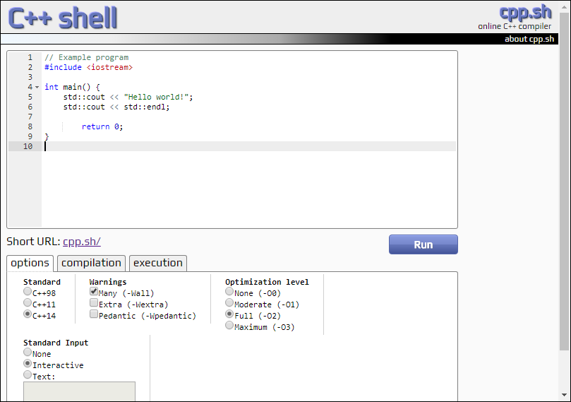
Our first program

Slide 10
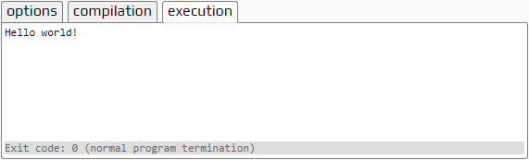
Our first program
When you select the Run button, text is printed to the console output

Slide 11
Summary
In this presentation, you now
Have an overview of how computers executing instructions
These are encoded in binary: 0s and 1s
Programming languages allow us to define programs using a human-readable interface
The program must be compiled into an executable and run
Our first program is the ubiquitous Hello world! program
We saw this output on http://cpp.sh
The first lab includes installing the Eclipse ide
You are not required to use Eclipse, but it is the only ide that is supported

Slide 12
References
[1] https://en.wikipedia.org/wiki/APL_(programming_language)

Slide 13
Acknowledgments
Proof read by Dr. Thomas McConkey

Slide 14
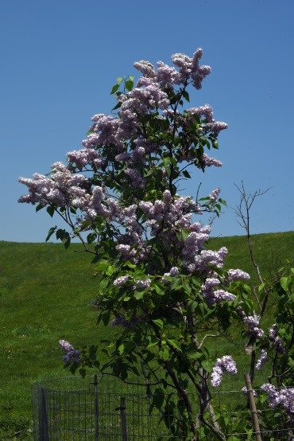

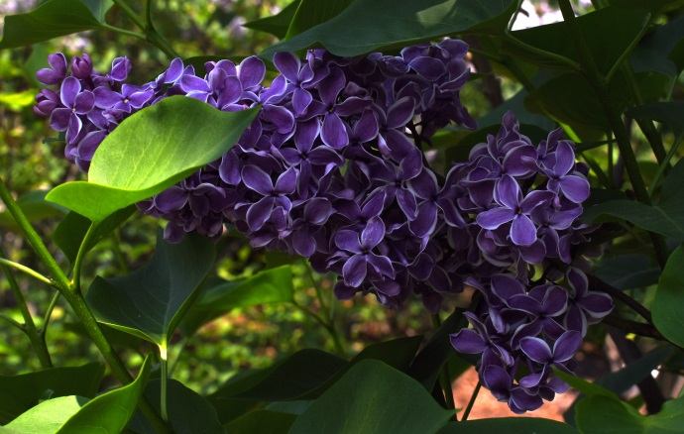
Colophon
These slides were prepared using the Georgia typeface. Mathematical equations use Times New Roman, and source code is presented using Consolas.
The photographs of lilacs in bloom appearing on the title slide and accenting the top of each other slide were taken at the Royal Botanical Gardens on May 27, 2018 by Douglas Wilhelm Harder. Please see
https://www.rbg.ca/
for more information.

Slide 15
Disclaimer
These slides are provided for the ece 150 Fundamentals of Programming course taught at the University of Waterloo. The material in it reflects the authors’ best judgment in light of the information available to them at the time of preparation. Any reliance on these course slides by any party for any other purpose are the responsibility of such parties. The authors accept no responsibility for damages, if any, suffered by any party as a result of decisions made or actions based on these course slides for any other purpose than that for which it was intended.

